Slide 1
Gyg Design Presentation
Shawn Mitchell
J. Anthony Timberlake
Jonathan Luetze
Isuru Nanayakkara
Drew Vivian

Slide 2

Problem
Find simple jobs to do in your area
Post new jobs that you need help with
Establish a trustworthy medium for getting tasks done

Slide 3
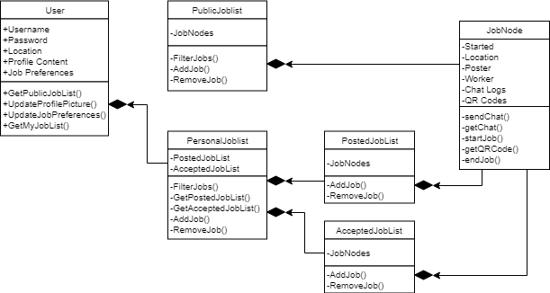
Class Diagram (Entire Diagram)

Slide 4
JobNode
JobNode
Public Job List
- Started
- Location
- Poster
- Worker
- Chat Logs
- QR Codes
- sendChat()
- getChat()
- startJob()
- getQRCode()
- endJob()
Posted Job List
Accepted Job List

Slide 5
Posted Job List
Posted Job List
- JobNode
- AddJob()
- RemoveJob()
Personal Job List
JobNode
Part of a tabbed view.
Combination of Recycler View + Adapter to handle list

Slide 6
Accepted Job List
AcceptedJobList
- JobNode
- AddJob()
- RemoveJob()
JobNode
Personal Job List
Have to decide if accepted job list is disjoint from posted job list
Other option is to mark a job as accepted in the posted job list section.

Slide 7
Personal Job List
PersonalJobList
- PostedJobList
- AcceptedJobList
- FilterJobs()
- GetPostedJobList()
- GetAcceptedJobList()
- AddJob()
- RemoveJob()
Posted Job List
User
Accepted Job List

Slide 8
Public Job List
Posted Job List
- JobNode
- FilterJob()
- AddJob()
- RemoveJob()
Personal Job List
JobNode

Slide 9
User
User
User can update their info
Will grab user location and job preference to present that areas job list
User can view their current jobs
+ UserName
+ Password
+ Location
+ Profile
+ Job Preference
+ getPublicJobList()
+ updateProfile()
+ updateJobPreference()
+ getMyJobList()
Personal Job List

Slide 10
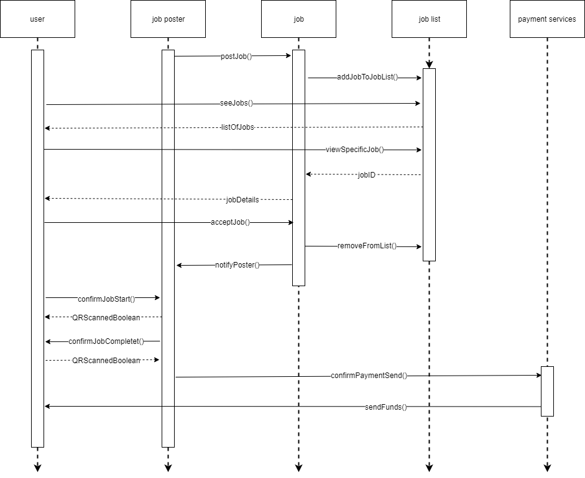
Sequence Diagram

Slide 11
User
seeJobs()
User can see their current jobs and all jobs available from the jobList
User can accept job and confirm job start and end after QR scan
Once Job is completed payment services will be holding the customers money and then send it to the user.
listOfJobs
viewSpecificJob()
jobDetails
acceptJob()
confirmJobStart()
QRScannedBoolean
confirmJobComplete()
QRScannedBoolean
sendFunds()

Slide 12
Job Poster
postJobs()
Job Poster will post a job
Job Poster will be notified that the job has been accepted by another user.
Job Poster will send a confirmation to Payment Services that job has been completed.
notifyPoster()
confirmPaymentSend()

Slide 13
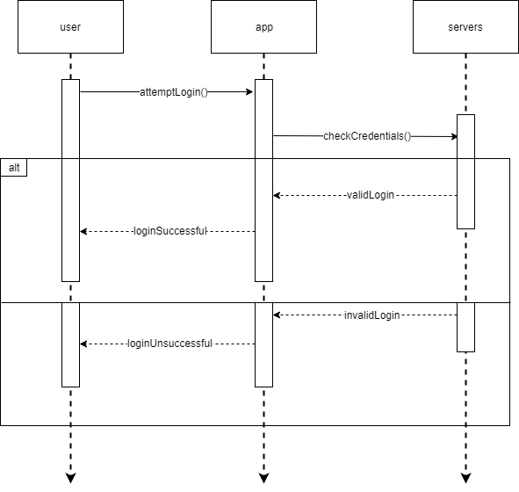
Login Sequence

